Slide 1
Load Control
East team
East Team
Manager | Sheneen Beckett | 2nd escalation contact
Supervisor | Susan Kidd | 1st escalation contact
5am-2pm TP | Brent Obershaw | Misc. CS locations in NC, AL, FL, TN to all destinations. Clinton and Wilson origins and Tar Heel plant/DC to IA, KS, MO, NE, IL, IN, MN, KY, SD, WI and MI
5am-2pm TP | Alana Jefferson | CPU’s, CCS Tar Heel to all destinations, Sanford to all Walmart rib locations, Inbounds, Misc. CS locations in GA, SC and NC. Tar Heel plant/DC to western states
5am-2pm TP | Tyree Henderson | Inbounds & VA origin loading planning, tendering and appointment scheduling (Daily Morning Late Truck Report)
8am-5pm TP | Michael Holland | Tar Heel plant/DC to FL
8am-5pm TP | Renee Thompson | Tar Heel plant/DC to GA, NC and SC
8am-5pm TP | Talibah Murnane | Tar Heel plant/DC to AL, AR, LA, MS, OK, TN, TX
8am-5pm TP | Travis Williams | MD origin load planning, tendering and appointment scheduling
8am-5pm TP | Latarsha Scott | PA, OH, NJ, NY origin loading planning, Domestic CPU’s, tendering and appointment scheduling (origin loading planning, tendering and appointment scheduling)
11am-8pm TP | Daniel Diaz | MD origin load planning, tendering and appointment scheduling
11am-8pm TP | Tom Bean | Tar Heel plant/DC to NJ, MA, MD, VA, NY, ME, OH and PA

Slide 2
Load Control
Midwest team
Midwest Team
Manager | Ben Moore | 2nd escalation contact
Supervisor | Ryan True | 1st escalation contact
5am-2pm TP | Samantha Mitchell | KY Origins/MN Origins/OH Origins/CPU
5am-2pm TP | Shanta Spencer | IL Origins/Inbound
8am-5pm TP | Stephanie Cornell | IL Origins/Inbound
8am-5pm TP | Addrenna Braxton | IN (Ship to IL/MO/NE/IA/SD/ND/MN/WI)
8am-5pm TP | Alvaro Torres | MO origins / WI Origins/Bulk
8am-5pm TP | Shaunda Salley | IA Origins: Denison & Westward
8am-5pm TP | Joshua Wynn | IN (Ship to OH/IN/KY/MI) Origins
8am-5pm TP | Eric McMillion | IA Origins: Des Moines and Eastward/CPU
11am-8pm TP | Lamont Harge | KY Origins/MN Origins/OH Origins/CPU

Slide 3
Load Control
West team
West Team
Manager | Sharanita Powell | 2nd escalation contact
Supervisor | Brittany Rivera | 1st escalation contact
5am-2pm TP | Dustin Holland | NE origins
8am-5pm TP | Ciara Roberts | KS Origins
8am-5pm TP | Shandricka Moss | CPU’s, Inbounds, Bulk
8am-5pm TP | Sunda Lynch | KS origins
8am-5pm TP | Olek Zhuk | SD/UT origins
8am-5pm TP | Paula Moor | NE origins
8am-5pm TP | Amber Thompson | KS origins
8am-5pm TP | Lynda Wilcox | Canada
11am-8pm TP | Tarrah Turner | NE origins

Slide 4
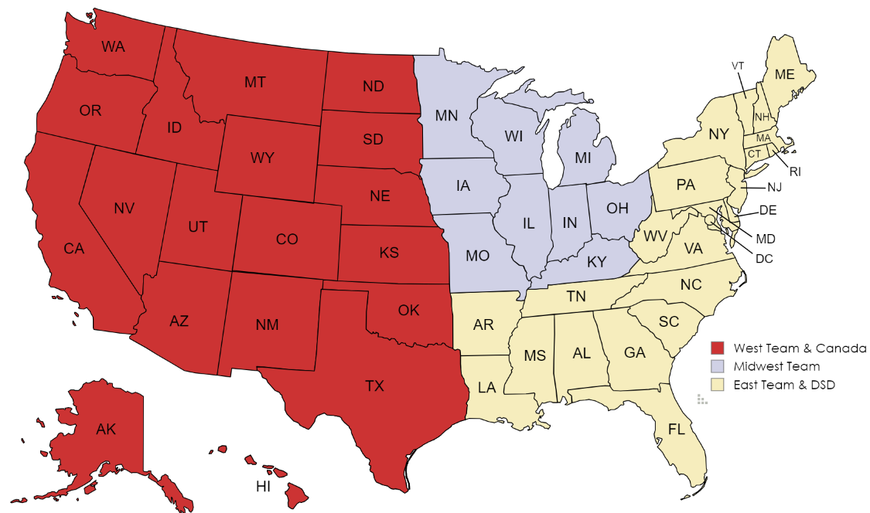
Late Order Approval/Escalation Contacts
Midwest-Ben Moore and Ryan True
West-Shari Powell and Brittney Rivera
East-Sheneen Beckett and Susan Kidd
Note all teams are setup based on origin location

Slide 5
Logistical Services
Logistical Services
Manager | Ann Torres | 2nd escalation contact
Supervisor | Jenn Strait | 1st escalation contact
Log Serv 1st shift
Amory Palmateer (HEB)/ Canada Tracking | Lakita Perry (AWG) | Charlene Murphy (Publix)/ Canada Tracking backup
Melissa Day (Save A Lot) | Emely Crispin Diaz (Supervalu) | Sarah Sledge (Kroger)
Sonya Diggs (Safeway) | Micheal Getman (Associated Foods & Winco) | Annette Melton (Cheney)
Cinda Brown (Costco) | Angela Artis (Chilled Exports) | Kim Crocker (C&S)
Alijah Aikens (Sam’s/ Walmart)
Log Serv 2nd shift
Wyley Yarber | Nijea Walker | Sheron Jones
Weekend Warriors
Weekend Supervisor | Dana Chandonnet | 1st escalation contact for weekend issues
Wanda Clarke | Jovanni Diaz | Walter Whitaker
Debbie Brady

